Slide 1
Top 4-5 user needs
1) personal support system consisting of productive conversation around stress and stress management
2) affordable/free and convenient therapy sessions
3) hobbies in which healthily decrease stress
4) option between in-person and online
5) ability to see reviews for therapists
3-5 key user tasks
1) find stress management tips (that can be sustainable and healthy)
2) explore a list of calming hobbies and activities to try
3) look at list of reviews and contact info of therapists (that charge less than average prices per hour, or even free services for certain demographics, or household income)
4) call a therapist for the chance to set-up recurring meetings

Slide 2
AFFINITY DIAGRAM

Slide 3
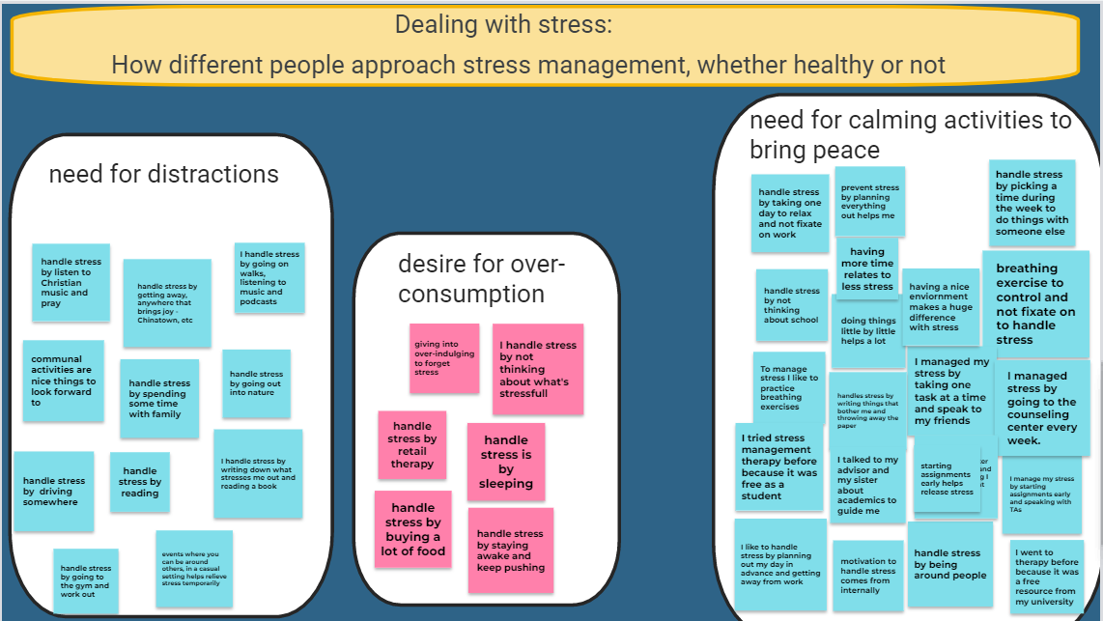

Slide 4
Dealing with Stress
a) Users care: Calming situations and things to do to take their mind off whatever is stressing them, hobbies or something they find entertaining to take away from their regular stress.
b) Breakdowns: Users do not want to spend too much time on these hobbies since they might cause problems with their workload and lead to more stress. It needs to be a quick distraction.
c) Holes: Are these methods helpful? on a scale of 1-10 how would they rate these stress management methods? what are unhealthy ways you deal with stress, which may not be something you wanna share about, but may be more accurate? we need to clarify if users want these fun/calming activities to be offered on campus or elsewhere…
d) Design Opportunities: Implementing calming exercises in the application, We can have a menu option which includes different activities that are offered to help them destress.

Slide 5
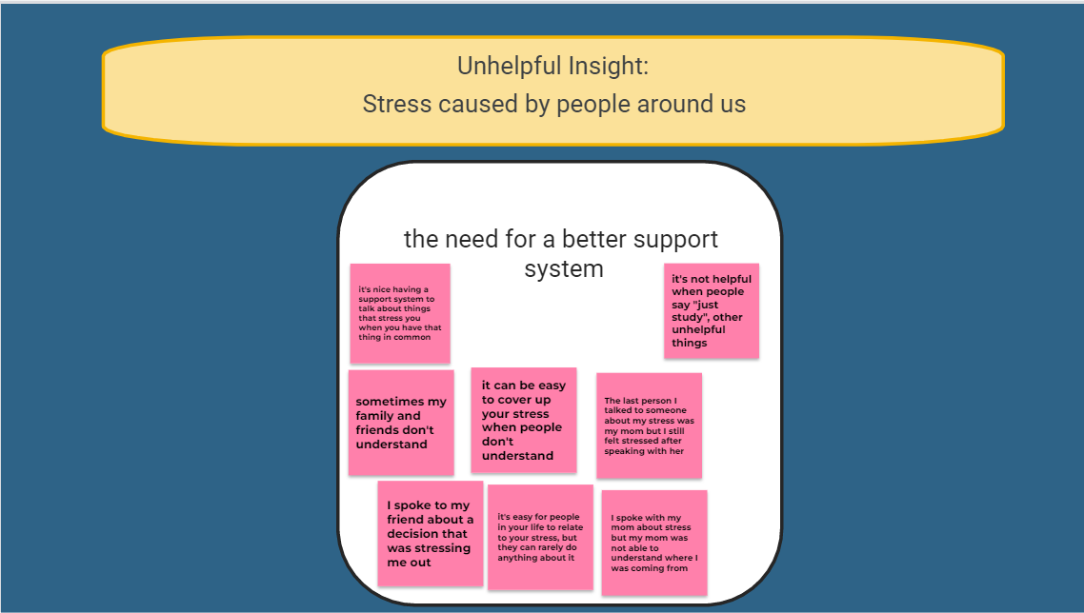

Slide 6
Unhelpful Insight
a) Users care: Users want to be surrounded by people that can offer them support or just be there to listen to what they are going through. They don't necessarily have to decrease their workload or directly influence their work.
b) Breakdowns: Having a reliable support system in their life that listens and understands. Some users feel that this kind of support isn't useful since it doesn't really decrease their workload.
c) Holes: How frequently they want the therapy sessions. They also need to figure out what exactly is needed from people around them to help them succeed.
d) Design Opportunities: The design can have the option for people to give feedback on how exactly people around them can help. We can also have the option to let people bring in their close family or friends to the sessions so they can also be guided better or how they can support the students and help them destress. Have 1 on 1 support system that students can talk with through the application.

Slide 7
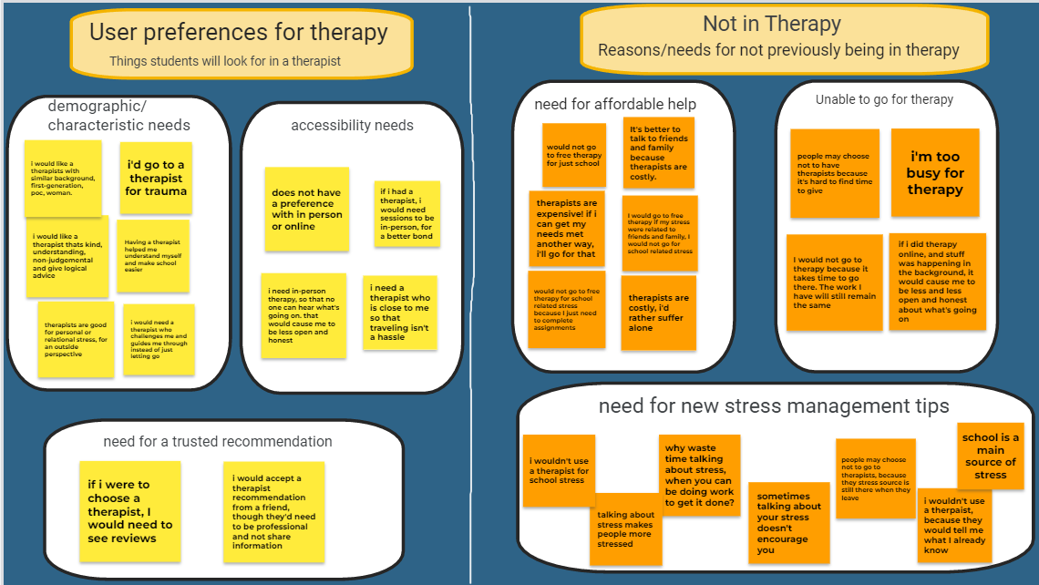

Slide 8
User Preferences for Therapy
a) Users care: having a therapist with similar background, gives constructive feedback, having the option between in-person/online, a recommended therapist
b) Breakdowns: finding a reliable and trusted therapist
c) Holes: what are some reasons users would use therapy for and how often do they feel they need it?
d) Design Opportunities: be able to see reviews of each therapist, be able to book online/in-person therapy sessions, know background info of therapist before booking a session

Slide 9
Not In Therapy
a) Users care: Users care about getting therapy in an affordable and convenient way. It needs to be offered in a way that doesn't increase their stress. Getting therapy the wrong way can have the opposite effect on the students and further increase their stress.
b) Breakdowns: Most students spoke about not being able to afford therapy and will only go if it is free of charge. This will require getting a grant or finding therapists that are willing to volunteer and offer free therapy sessions. Also, most students will not be able to commute to the therapy session locations and might need to attend it virtually or on-campus.
c) Holes: Users still need to clarify on how many sessions they will (how frequently) and if they are willing to have group sessions so that way more students will be able to attend a therapy session even though it won't be a one-on-one session. This will however allow us to keep therapy sessions free or affordable.
d) Design Opportunities: We can include an option to have virtual sessions for students that have an issue with commuting. We can also include an option to opt in for group sessions.

Slide 10
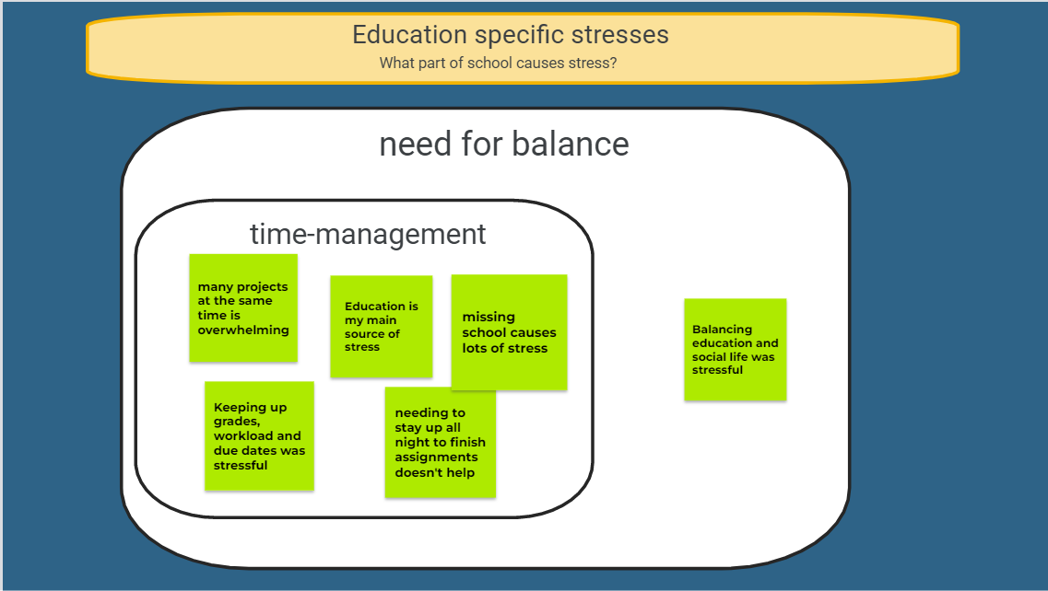

Slide 11
Education Specific Stresses
a) Users care: having more time to complete their responsibilities; doing one thing at a time; less course load; how much work they take on; social life balance w/ education; they care about education, but also doing it right and smartly; keeping track of due dates.
b) Breakdowns: too much work, no play; still having to go to school when responsibilities aren't done and need to be; multiple things to work on at once.
c) Holes: what are other sources of stress? within your personal life? what helps you navigate that?
d) Design Opportunities: calendar, time management tips easily accessible

Slide 12
PERSONAS

Slide 13

Jaleesa Graham
Jaleesa is a junior majoring in Chemical Engineering. During the weekends, she works part time as barista at her local coffee shop. In her free time she likes to explore the city with her friends and catch up on her favorite tv series. As a full time student, balancing her social life, work and grades is frustrating. Jaleesa also deals with anxiety which has impacted her academic performance and overall well-being. When she’s stressed she likes to listen to music and reads but she wishes she could talk to someone about her problems.
> Biographic Information
20, Female
College Student at UIC
> Ideal Features
Have the option to view reviews of therapists
Journaling exercises
> Motivations
Getting good grades
Hanging out with friends
> Needs
In order of preference
A therapist that comes from similar background as her
Having the option between remote and in-person therapy
> Frustrations
Keeping up with grades, workload and due dates
Not being able to talk to her family about her stress
The cost of therapy

Slide 14

Amy garcia
Amy is a full time student on her 4th year majoring in Electrical Engineering. She works part time after her classes and during weekends. When she’s not working, she spends her time at the library studying for exams. Amy has set high standards for herself, maintaining a 4.0 GPA throughout college, but often experiences burnout. Apart from that, she finds it challenging with dealing with imposter syndrome, given that she is one of the few female students in her engineering classes. As a student, she doesn’t have the fund to afford therapy but knows it will help her deal with her stress. To cope, she meditates, exercises and listens to music.
> Biographic Information
22 Female
Student at UIC
> Motivations
Spending time with her family
Working on her career and future goals
Achieving good grades and academic scholarships
> Ideal Features
Stress Management exercises
Ability to have in-person therapy option
Breathing exercises and meditation
> Frustrations
> Needs
In order of preference
Free or affordable therapy
Female therapist
Book therapist online
High expectations and school workload
Balancing school and social life
Limited mental health resources available
Financial stress from school and living expenses

Slide 15

Sara Don
Sara is a second-year Computer Science foreign student and is also working part-time as a TA. She struggles to balance her school and personal life while having to work on the side. She doesn’t have any family or friends in the same country so she feels she is alone and doesn’t have anyone to discuss her stress-related issues with. Sara really wants to excel in her studies especially because she feels her parents have worked so hard to send her here. One way she socializes is by being part of different student organizations.
> Biographic Information
19, Female
Student at UIC
> Motivations
Working on her career and future goals
Achieving good grades and academic scholarships
Making her family proud
> Ideal Features
Stress Management exercises
Being able to connect with other people
> Frustrations
> Needs
In order of preference
Free or affordable therapy
Flexible timing
Therapist that understands her background
Not having friends or family closeby
Struggling with coursework
Limited mental health resources available

Slide 16
Design Ideas
Implementation of calming exercises such as meditation, journaling and breathing exercises.
User need #3
Implementation of rating therapist and viewing their reviews from other students
User need #5
Option to book in person and online therapy sessions
User need #4
Have an “about me” section for therapist so students can learn more about them before booking a session. This can include pricing for each therapist so students can find the most affordable therapist.
User need #5 & #2
Implementing a stress management tips section
User need #3
The ability to anonymously chat with other students who use the app, and talk through things that are stressing them with people who can actually relate
User need #1
The option to apply for a student discount if you are a current student.
User need #2

Slide 17
Final Concept:
We will create a website that focuses on the ability to connect women college students with affordable therapy options. Many students are in need of sustainable stress management options, whether through therapy or through activities that they can do on their own. We hope to provide some sort of assistance to them no matter which medium they choose. When you come to our webpage, the home page will be a welcoming page that emphasizes the help that we provide. The students will be able to navigate to where they would like to go from the home page, or through a navigation menu at the top. The navigation menu will have options for looking for a therapist, scheduling a first appointment with a therapist, rate your therapist, and looking at stress management tips. Wherever you navigate to, we’ll also have a chat room icon at the bottom right of your screen so you can anonymously chat with other students about things that are stressing you. You will also have the option for entering in your student details to check if you are eligible for a student discount.

Slide 18
SCENARIOS

Slide 19
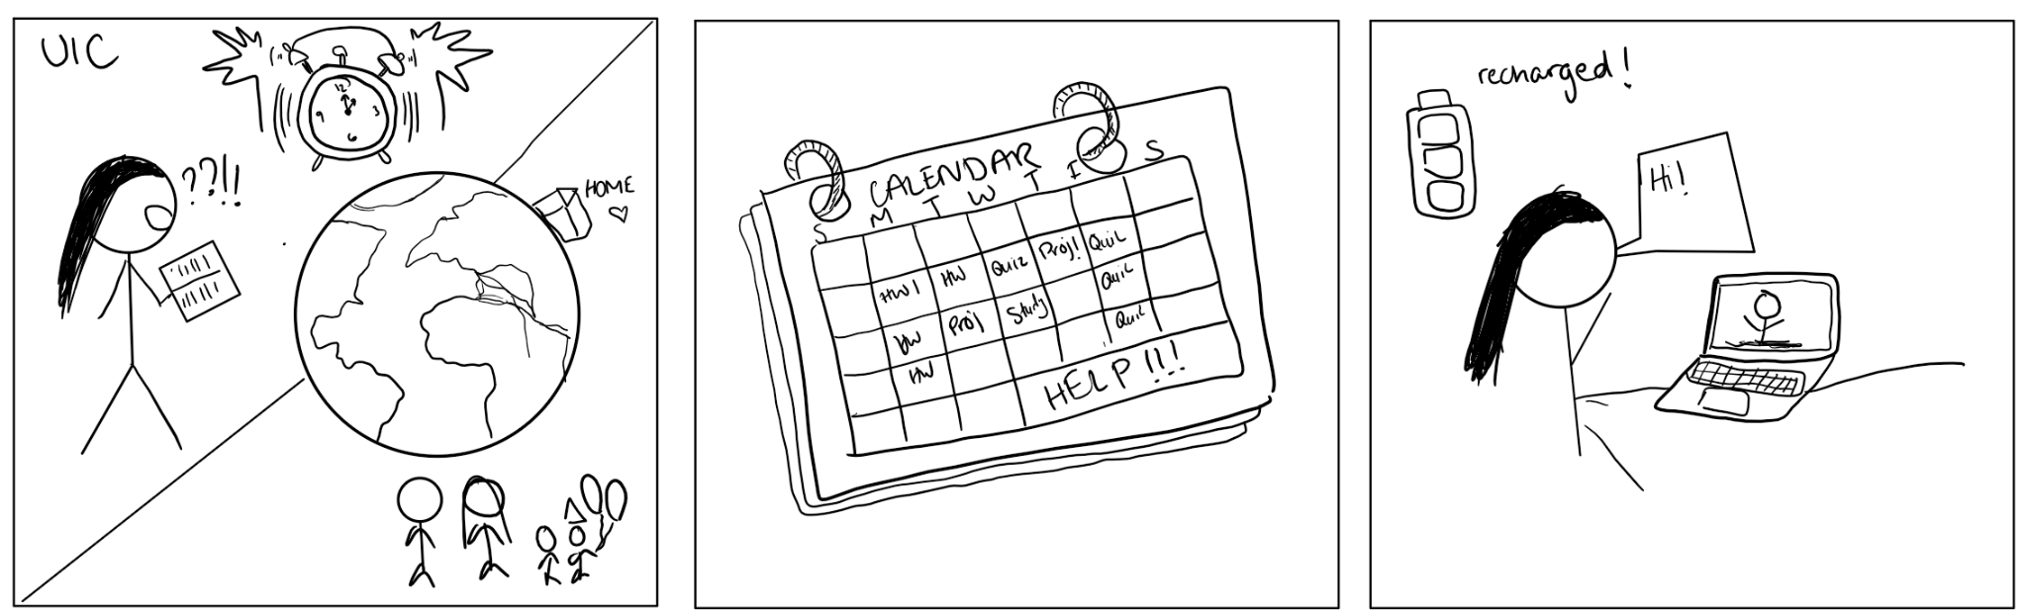
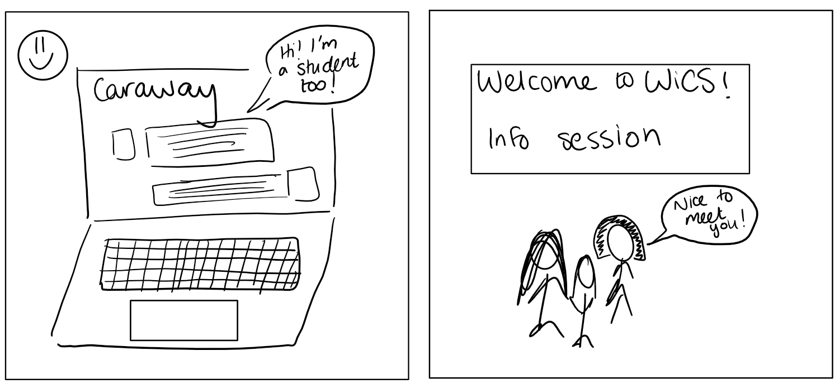
Scenario #1
Sara is a foreign student at UIC and is majoring in Computer Science. She doesn’t have any close friends or family in the country and feels is alone when it comes to talking about personal or even school related issues. She has started using the therapy app and has attended around two therapy sessions so far. She chose her therapist based off of reviews and after reading the ‘About Me’ section and selecting the therapist she felt she could best connect with. She is also making use of the anonymous chat feature where she can talk to other students, recommended by the therapist, that are also going through what she is. She has been attending her sessions virtually since she doesn’t have a car to commute to different places. Also, she is eligible for a student discount since she has put in her student details so the therapy sessions are affordable. The therapy sessions have been helpful in her overall stress management and Sara and her anonymous peer are both planning on joining a student organization so they have a better support system.
Sara is a foreign student and struggles with stress management, especially since she feels she is alone in a new country.
She is overwhelmed with work and meeting deadlines. She feels pressured that she needs to do well since her parents worked so hard to send her here.
She sees an ad for student discounted therapy sessions offered by Caraway and decides to give it a go. After her first virtual session she feels a lot more energized and ready for her next week.
She also starts making use of the anonymous chatting feature and feels she is able to connect with other students that are going through something similar.
She uses the stress management techniques the therapist discussed and feels it helped her a lot. As the therapist recommended, she joined some student organizations so she has a better support system.

Slide 20
Scenario #1
Sara is a foreign student and struggles with stress management, especially since she feels she is alone in a new country.
She is overwhelmed with work and meeting deadlines. She feels pressured that she needs to do well since her parents worked so hard to send her here.
She sees an ad for student discounted therapy sessions offered by Caraway and decides to give it a go. After her first virtual session she feels a lot more energized and ready for her next week.
She also starts making use of the anonymous chatting feature and feels she is able to connect with other students that are going through something similar.
She uses the stress management techniques the therapist discussed and feels it helped her a lot. As the therapist recommended, she joined some student organizations so she has a better support system.

Slide 21
Scenario #1
Sara is a foreign student at UIC and is majoring in Computer Science. She doesn’t have any close friends or family in the country and feels is alone when it comes to talking about personal or even school related issues. She has started using the therapy app and has attended around two therapy sessions so far. She chose her therapist based off of reviews and after reading the ‘About Me’ section and selecting the therapist she felt she could best connect with. She is also making use of the anonymous chat feature where she can talk to other students, recommended by the therapist, that are also going through what she is. She has been attending her sessions virtually since she doesn’t have a car to commute to different places. Also, she is eligible for a student discount since she has put in her student details so the therapy sessions are affordable. The therapy sessions have been helpful in her overall stress management and Sara and her anonymous peer are both planning on joining a student organization so they have a better support system.

Slide 22
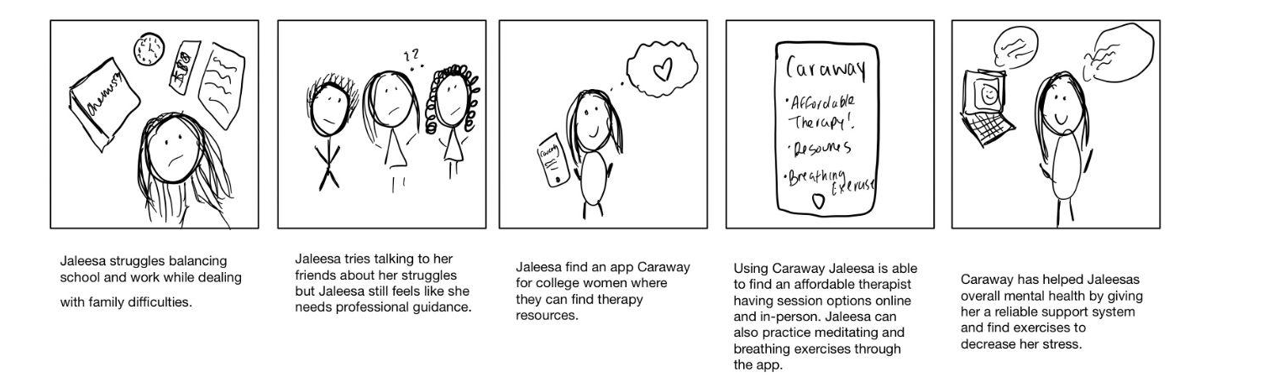
Scenario #2
Jaleesa Graham is a junior at at UIC, currently she is working part time at a local coffee shop while being a full time student. Recently, she’s felt stressed as her family is having financial difficulties and she has needed to work longer hours at the store. Her grades have been dropping and she wishes she had a support system to talk to about her stress. She’s tried talking to her friends about it but they don’t understand as they’ve never been in her situation. She stumbled online and saw Caraway - a therapy app made for female students. Using the app she’s able to find an affordable therapist based on her income and student status. She’s also able to view recommended therapist from other students and have the option to learn more about the therapist before booking a session. Jaleesa has the option between online and in-person sessions so if she’s in a time crunch and can’t commute she’ll be able to do it through the app. When Jaleesa feels anxious Caraway has breathing and meditation exercises to calm her down. Caraway has made a positive impact on Jaleesas’ overall mental health by giving her a reliable support system she can talk with and find ways to decrease her stress.

Slide 23
Scenario #2

Slide 24
Scenario #2
Jaleesa Graham is a junior at at UIC, currently she is working part time at a local coffee shop while being a full time student. Recently, she’s felt stressed as her family is having financial difficulties and she has needed to work longer hours at the store. Her grades have been dropping and she wishes she had a support system to talk to about her stress. She’s tried talking to her friends about it but they don’t understand as they’ve never been in her situation. She stumbled online and saw Caraway - a therapy app made for female students. Using the app she’s able to find an affordable therapist based on her income and student status. She’s also able to view recommended therapist from other students and have the option to learn more about the therapist before booking a session. Jaleesa has the option between online and in-person sessions so if she’s in a time crunch and can’t commute she’ll be able to do it through the app. When Jaleesa feels anxious Caraway has breathing and meditation exercises to calm her down. Caraway has made a positive impact on Jaleesas’ overall mental health by giving her a reliable support system she can talk with and find ways to decrease her stress.

Slide 25
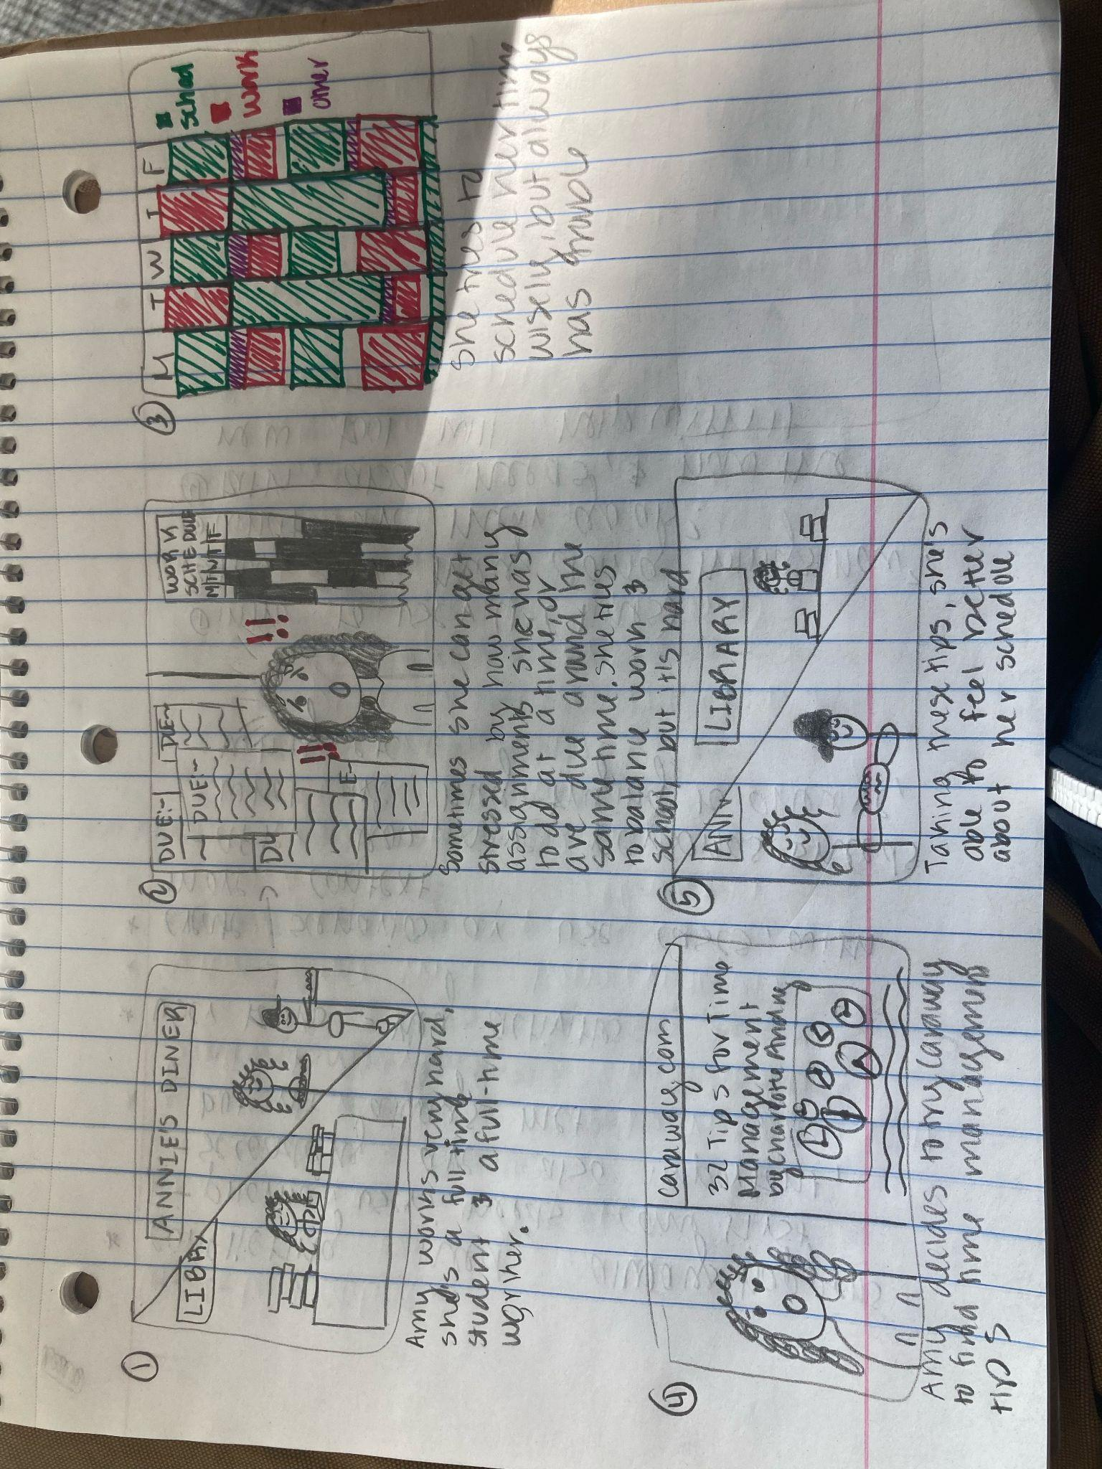
Scenario #3 - Amy Garcia
This week, Amy had multiple assignments to work on across her classes, and found herself feeling anxious, as she also had to work extra hours this week. Lately, she’s been finding it hard to balance school with work, and also having time to rest. The new Caraway website will allow her to find someone to talk to about time management, and allow her to find breathing exercises to try when she finds herself feeling the most anxious.Using the website, she can find a therapist who can be free for her as an independent student. She can also use the website’s anonymous chat for faster responses to questions she has for how students balance work with their course load. Other students in the chat can message her about ways they’ve been able to manage. Since she already uses mediation as a way to help her, she can also share that in the chat to help others. With this website, Amy is able to get an abundance of help, whether it’s short term or long term.

Slide 26
Scenario #3 - Amy Garcia

Slide 27
Scenario #3 - Amy Garcia
This week, Amy had multiple assignments to work on across her classes, and found herself feeling anxious, as she also had to work extra hours this week. Lately, she’s been finding it hard to balance school with work, and also having time to rest. The new Caraway website will allow her to find someone to talk to about time management, and allow her to find breathing exercises to try when she finds herself feeling the most anxious.Using the website, she can find a therapist who can be free for her as an independent student. She can also use the website’s anonymous chat for faster responses to questions she has for how students balance work with their course load. Other students in the chat can message her about ways they’ve been able to manage. Since she already uses mediation as a way to help her, she can also share that in the chat to help others. With this website, Amy is able to get an abundance of help, whether it’s short term or long term.

